Slide 1
Background Processing
our unexpectedly long journey

Slide 2


Slide 3



Slide 4

Karl Becker
CTO, Co-Founder of

Slide 5

We create BrowZine

Slide 6
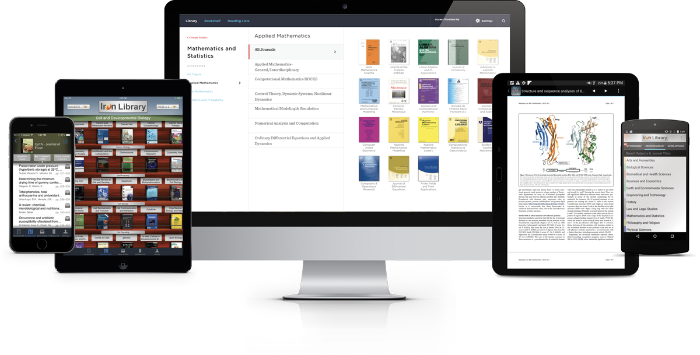
BrowZine is the world's most popular academic journal reading and engagement service.
Used by hundreds of universities, hospitals, government research labs, and companies around the world.

Slide 7
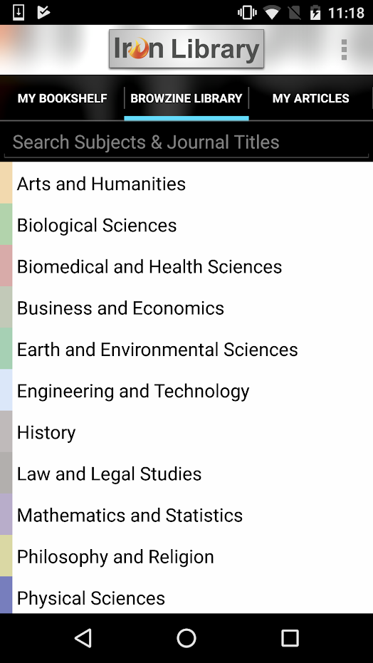
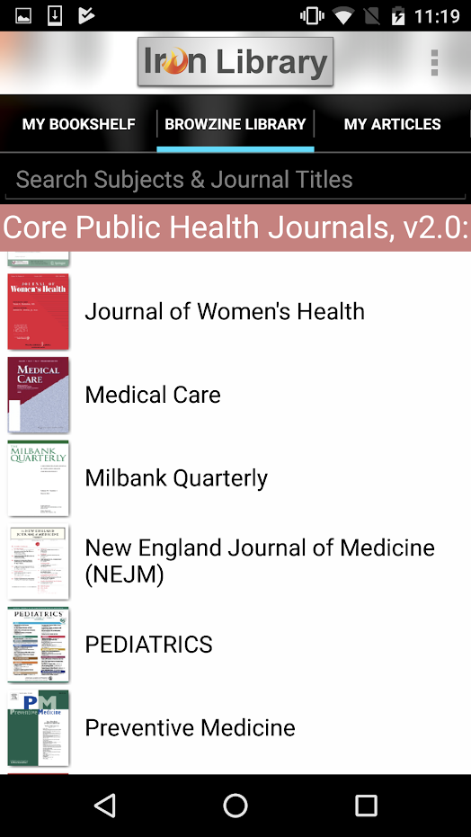
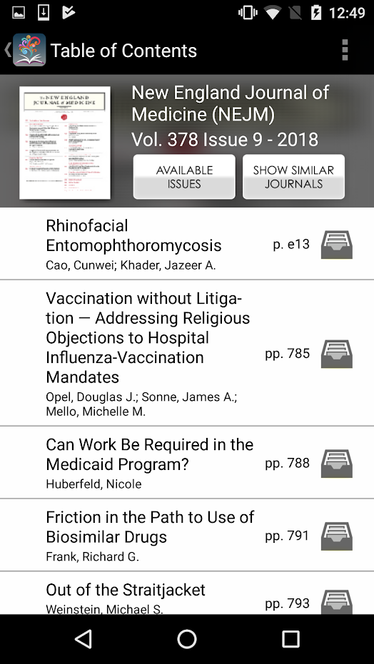

Slide 8
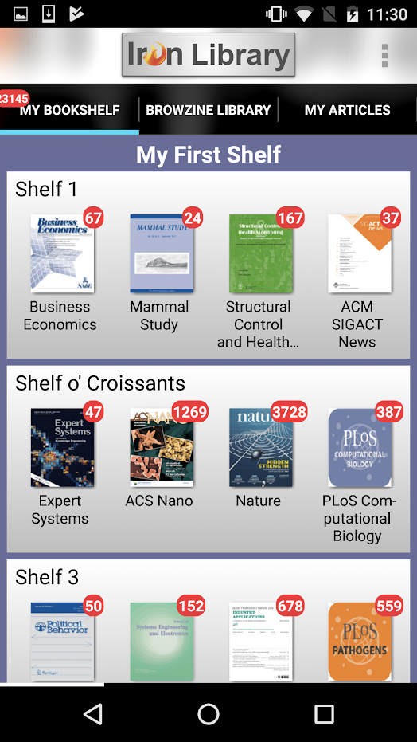
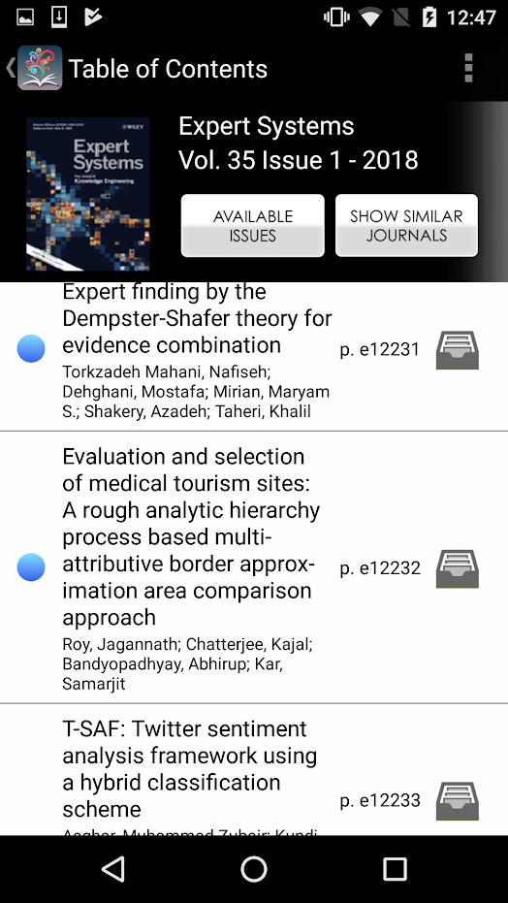

Slide 9
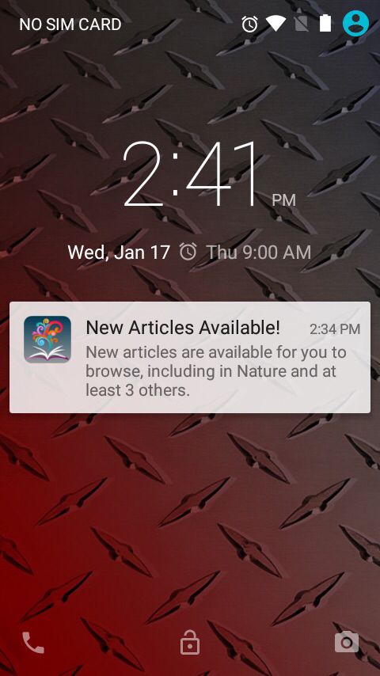
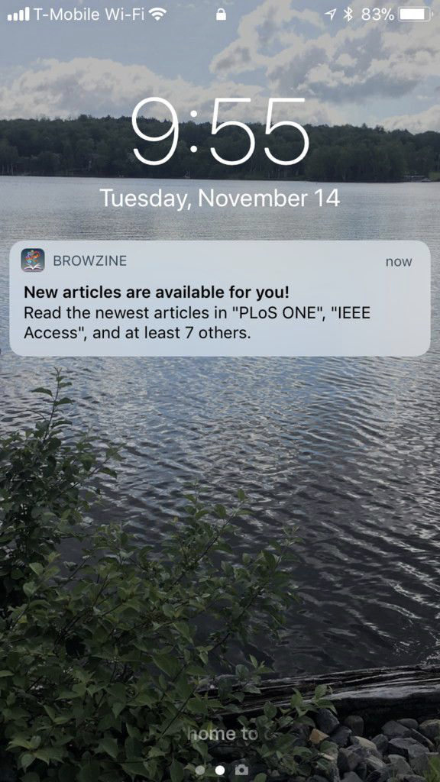
Our primary goal: notifications

Slide 10

Our primary goal: notifications

Slide 11
Why not push notifications?

Slide 12
More iOS & Android developer time available

Slide 13
Initial effort seemed pretty small

Slide 14
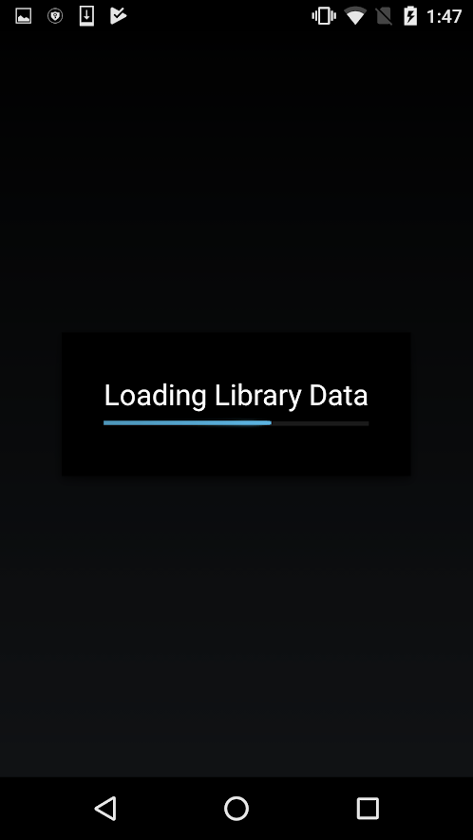

Secondary goal: less loading

Slide 15
Android push notification
best practices churn
At least 3,
even when excluding Amazon Fire devices

Slide 16
How did it go?

Slide 17
Quick initial implementation!

Slide 18
Long testing phase

Slide 19
Loooooooong testing phase

Slide 20
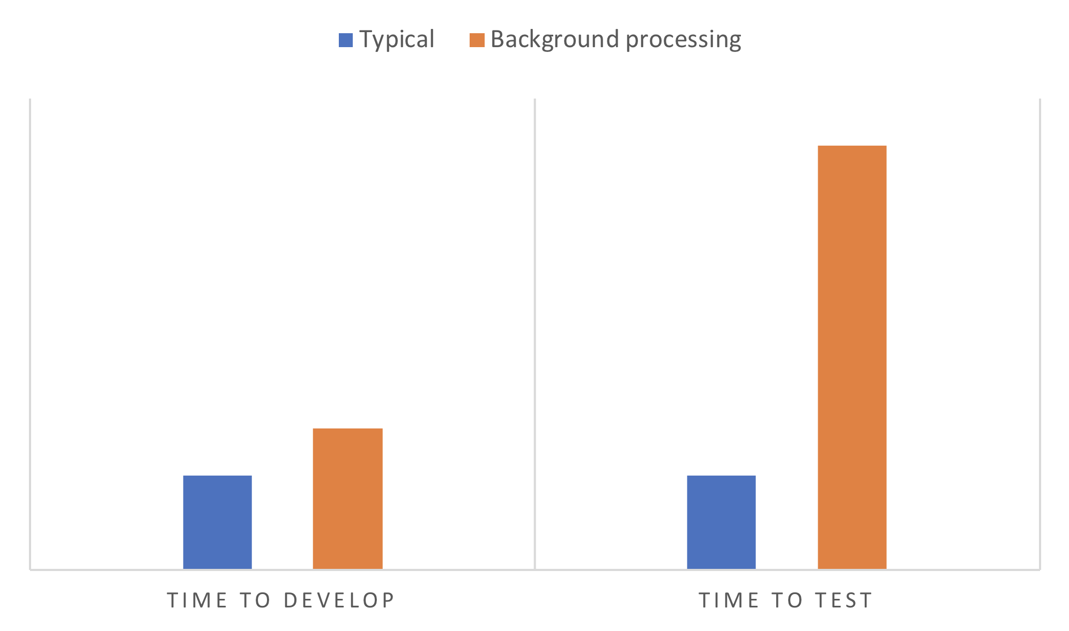

Slide 21
Why did bg processing testing take so long?
Our product’s use case
Platform differences
Battery optimizations
Notification-specific issues
Bg processing specifics
Usage tracking

Slide 22
Real-world end-to-end testing
has long turnaround times

Slide 23
Real-world end-to-end testing takes a long time
Our use case is a little different than, say, Twitter

Slide 24
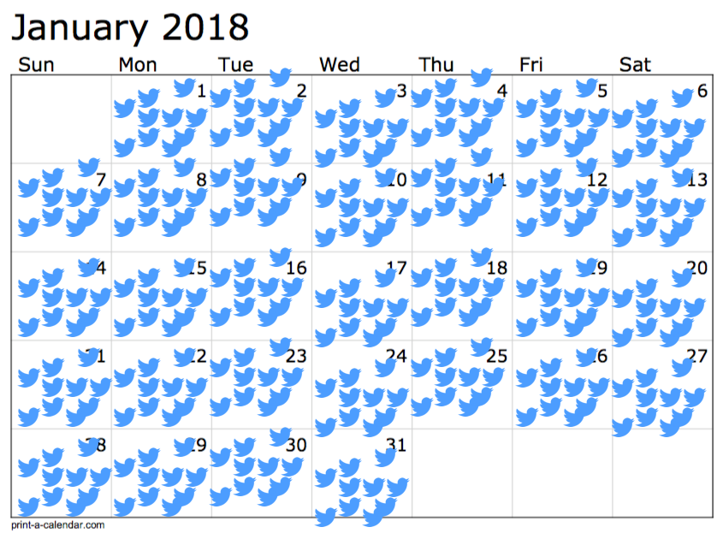
Typical Twitter publication schedule

Slide 25
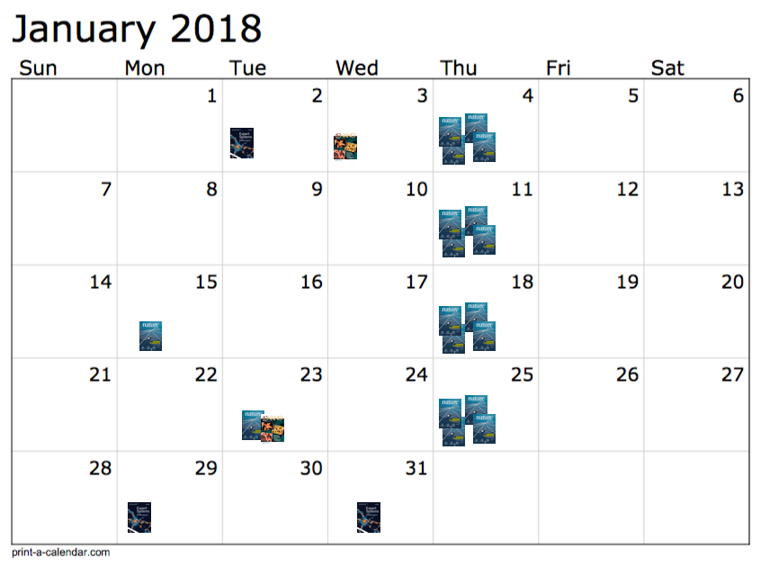
Typical BrowZine journal article publication schedule

Slide 26
A tablet could be sitting idle for days until this fires
Notes:
That realistic “I put my phone to sleep for 8 hours, will I get the notification in the morning either when I wake up or maybe around the time I get to work?” use case was important.
No way to speed up letting a device sit for multiple hours.

Slide 27
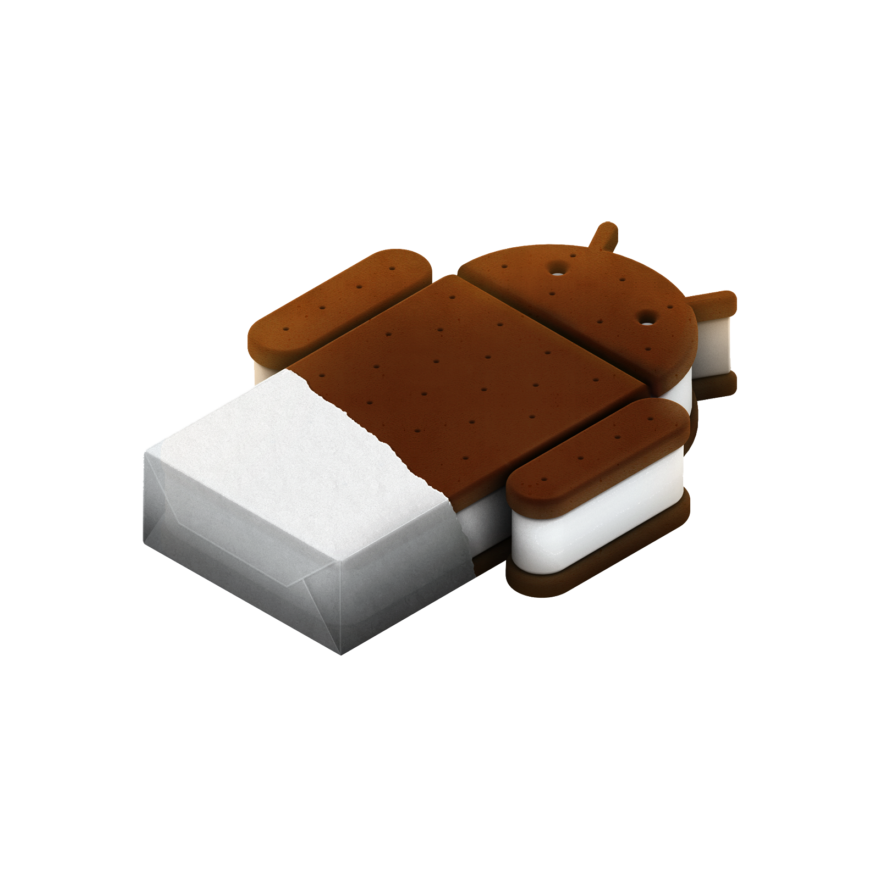
Supporting old versions of Android
We support back to Android 4.0, Ice Cream Sandwich (API 14)
Things would be different if we only supported back to version 21 and could have used JobScheduler
14

Slide 28
Why did bg processing testing take so long?
Our product’s use case
Platform differences
Battery optimizations
Notification-specific issues
Bg processing specifics
Usage tracking

Slide 29
Consider Android & iOS UX differences
Expected user behavior & UI organization is different
Once you understand the differences in iOS and Android notifications, talk with your product owner to clarify desired behavior

Slide 31
Why did bg processing testing take so long?
Our product’s use case
Platform differences
Battery optimizations
Notification-specific issues
Bg processing specifics
Usage tracking

Slide 32
Beware the 3 Levels of Sleep
Registered alarms don’t necessarily ever fire when device is in the deepest level
Registered alarms usually fire when the device is woken up again

Slide 33
AlarmManager triggers alarms inexactly
From the AlarmManager docs: Beginning with API 19 (KITKAT) alarm delivery is inexact: the OS will shift alarms in order to minimize wakeups and battery use.
From the Intelligent Job-Scheduling docs: The AlarmManager API … is useful in cases in which an app needs to post a notification or set off an alarm at a very specific time.

Slide 34

the AlarmManager docs:
alarm delivery is inexact
the Intelligent Job-Scheduling docs:
useful … to post a notification or set off an alarm at a very specific time

Slide 35
AlarmManager triggers alarms inexactly
Do not expect your alarm to trigger at the time you asked

Slide 36
Wakeup with no internet
Right after wakeup, it’s common for a device to have no internet
Could add a listener for connectivity, but it can give false positives and is tricky to setup
Easier option: wait a couple seconds before your network call, and retry it once or twice, too

Slide 37
Why did bg processing testing take so long?
Our product’s use case
Platform differences
Battery optimizations
Notification-specific issues
Bg processing specifics
Usage tracking

Slide 38
You shall wait
A posted notification may not appear for several seconds, or even minutes, after device is woken up
Even if it was posted hours before

Slide 39
Track if you already posted a notification
No official way to tell if an existing notification is posted
(at least for us supporting back to level 14, ICS)
Track that state yourself, and simply hope it is in sync with reality

Slide 40
Why did bg processing testing take so long?
Our product’s use case
Platform differences
Battery optimizations
Notification-specific issues
Bg processing specifics
Usage tracking

Slide 41
Once registered, twice fired
When you register an alarm once, it can fire twice, back-to-back, on some hardware
Store a “last time woken,” and bail out if the second wakeup is too close to the first one

Slide 42
Handle device power off
Alarms registered with Android are deleted on device power off
Use a Boot Receiver to listen for when the device boots up again and re-register your alarms

Slide 43
Running in foreground or background?
There’s no official way to tell if your code is running in the foreground or background - here’s an SO discussion, and another one
The alarms to run your IntentService can fire while your app is in the foreground
Decide if that matters for your use case

Slide 44
App can start while bg processing
Someone might tap the icon of your app to open it while background processing is happening
No weird implementation bugs, but one more scenario to consider

Slide 45
Prepare for erraticness
The magic spell for desired behavior might be tricky to divine
Since alarm behavior is so erratic, it prolongs the trial and error testing phase.
Determining if things are working is pattern analysis than definitively stating “100% working all the time”
Not fun for your QA team

Slide 46
Target latest APIs if possible
Targeting API 21 and up? Use JobScheduler instead of AlarmManager
Android's notification query/posting/updating API is also more robust in later versions.

Slide 47
Why did bg processing testing take so long?
Our product’s use case
Platform differences
Battery optimizations
Notification-specific issues
Bg processing specifics
Usage tracking

Slide 48
Avoid skewing your metrics
Running your app in the background may drastically increase the number of sessions
Empirically verify what your analytics library does while your background process runs
Consider sending background sessions & foreground sessions to two different buckets

Slide 49
Post-rollout learning

Slide 50
Android notifications get tapped on much more frequently than iOS
3X for us

Slide 51
Usage stats for bg processing help confirm if you’re running as expected

Slide 52
Notifications did increase usage!

Slide 54
Major Lessons Learned
Easy to implement, hard to test and tweak
Schedule at least 2X more time to test background processing than a typical change to your software
Support Android API 21 (Lollipop) and newer if possible
Do not expect background processing to happen at specific times
Think extra carefully about usage tracking
Expect more Android users to tap notifications than iOS

Slide 55
Thanks!
browzine.com
twitter.com/karlbecker_com
thirdiron.com

